Slide 1
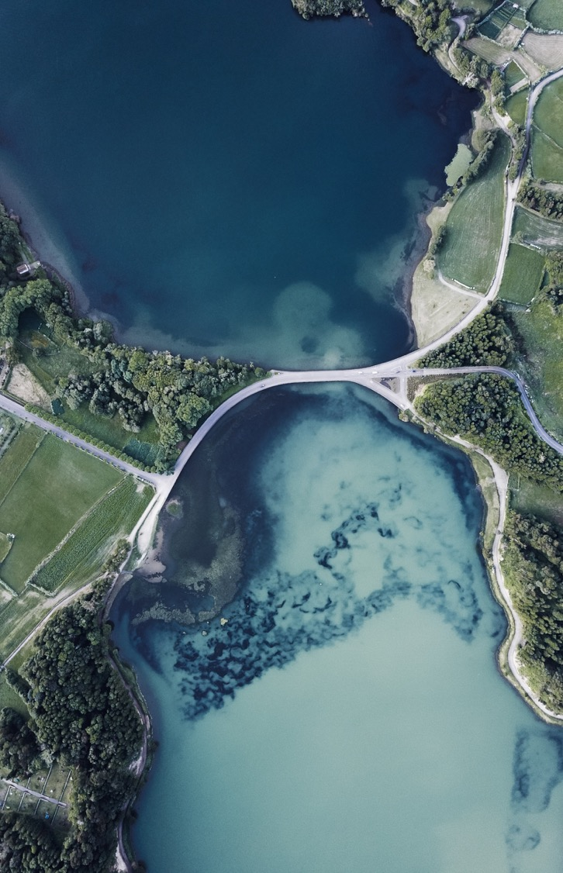
Presentation of Group 6

Slide 2

Introduction
This assignment is for developing a site using a CMS.
Any Non-technical Person can use this site with the CMS.
Non-Technical person not related to technique or technical skills or subjects.
Not being or using technical or specialized terminology

Slide 3
Why we use cms
Mainly known as Content Management System.
An enterprise content management system is the beating heart of their organization’s digital presence.
Since CMS makes use of templates, little to no HTML knowledge is required.
CMS users can employ a range of document types and content on a website

Slide 4
Benefits of cms
User Friendly Features
For Any Size Business
Instant Content Updates
Improves Collaboration And Sharing
Accessible From Anywhere
Quick, Easy Integration
Custom Permissions

